Slide 1


Chunked, Compressed, & Cloud-native N-dimensional arrays
CSCCE Open Source Tools Trials
Managing technical documentation using GitHub

Slide 2

Sanket Verma
@MSanKeys963
Community Manager @ Zarr

Slide 3
What I’ll be talking?
👉🏻 How to setup GitHub repositories for docs
👉🏻 What is the Zarr Community?
👉🏻 How we use Git & GitHub to manage the Zarr Specification?
👉🏻 Peak into the ZEP Process

Slide 4
How to setup GitHub repos for docs? 🛠️

Slide 5

ReadtheDocs Template
GitHub Repository
https://github.com/readthedocs/tutorial-template

Slide 6
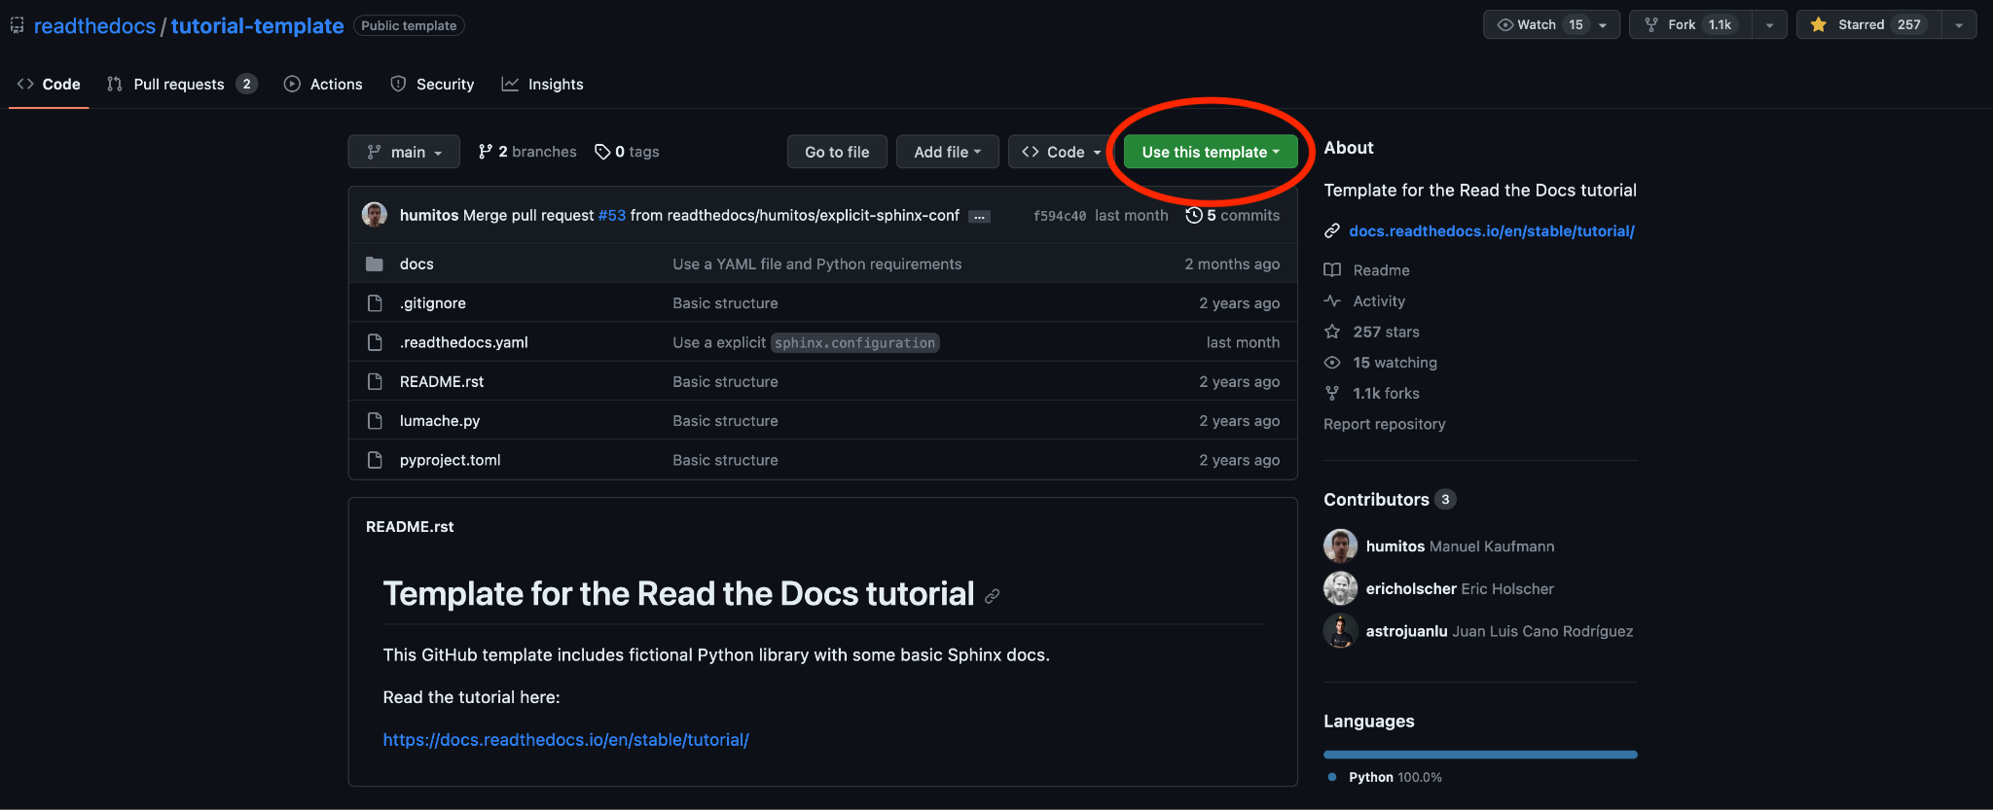

Slide 7
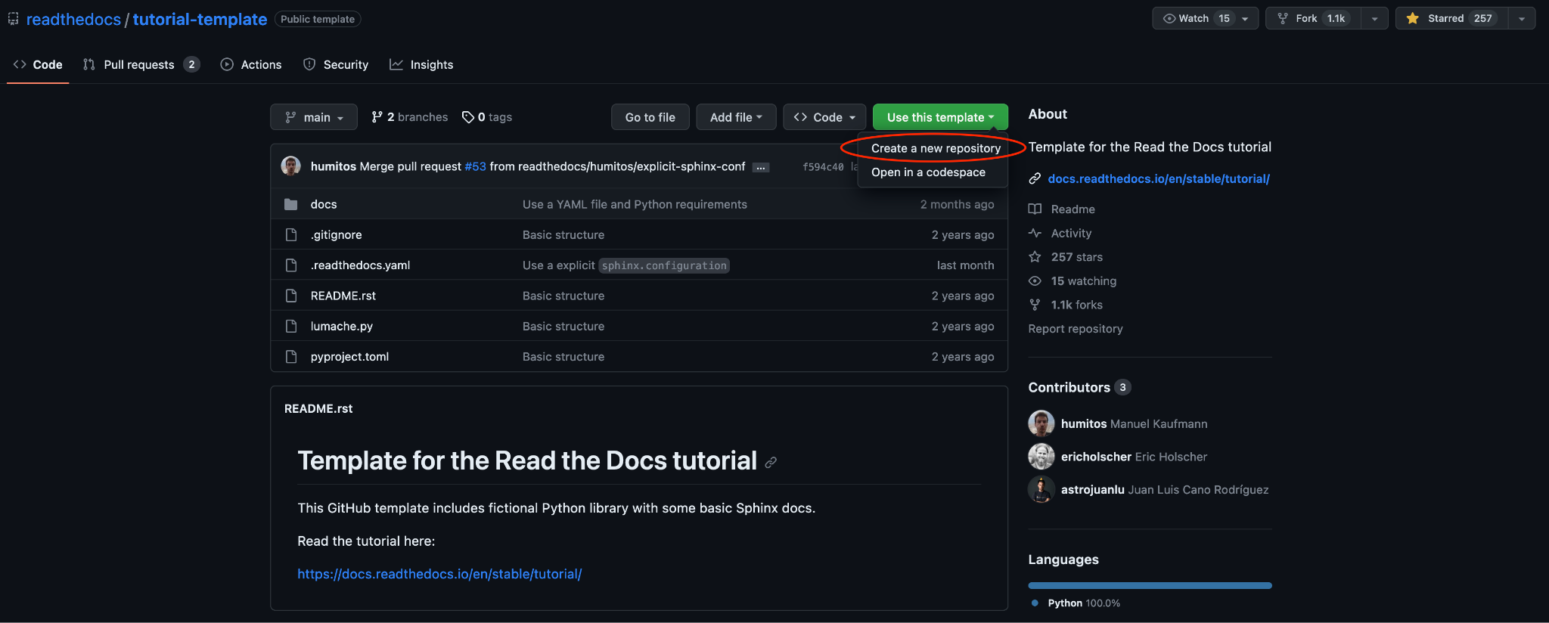

Slide 8
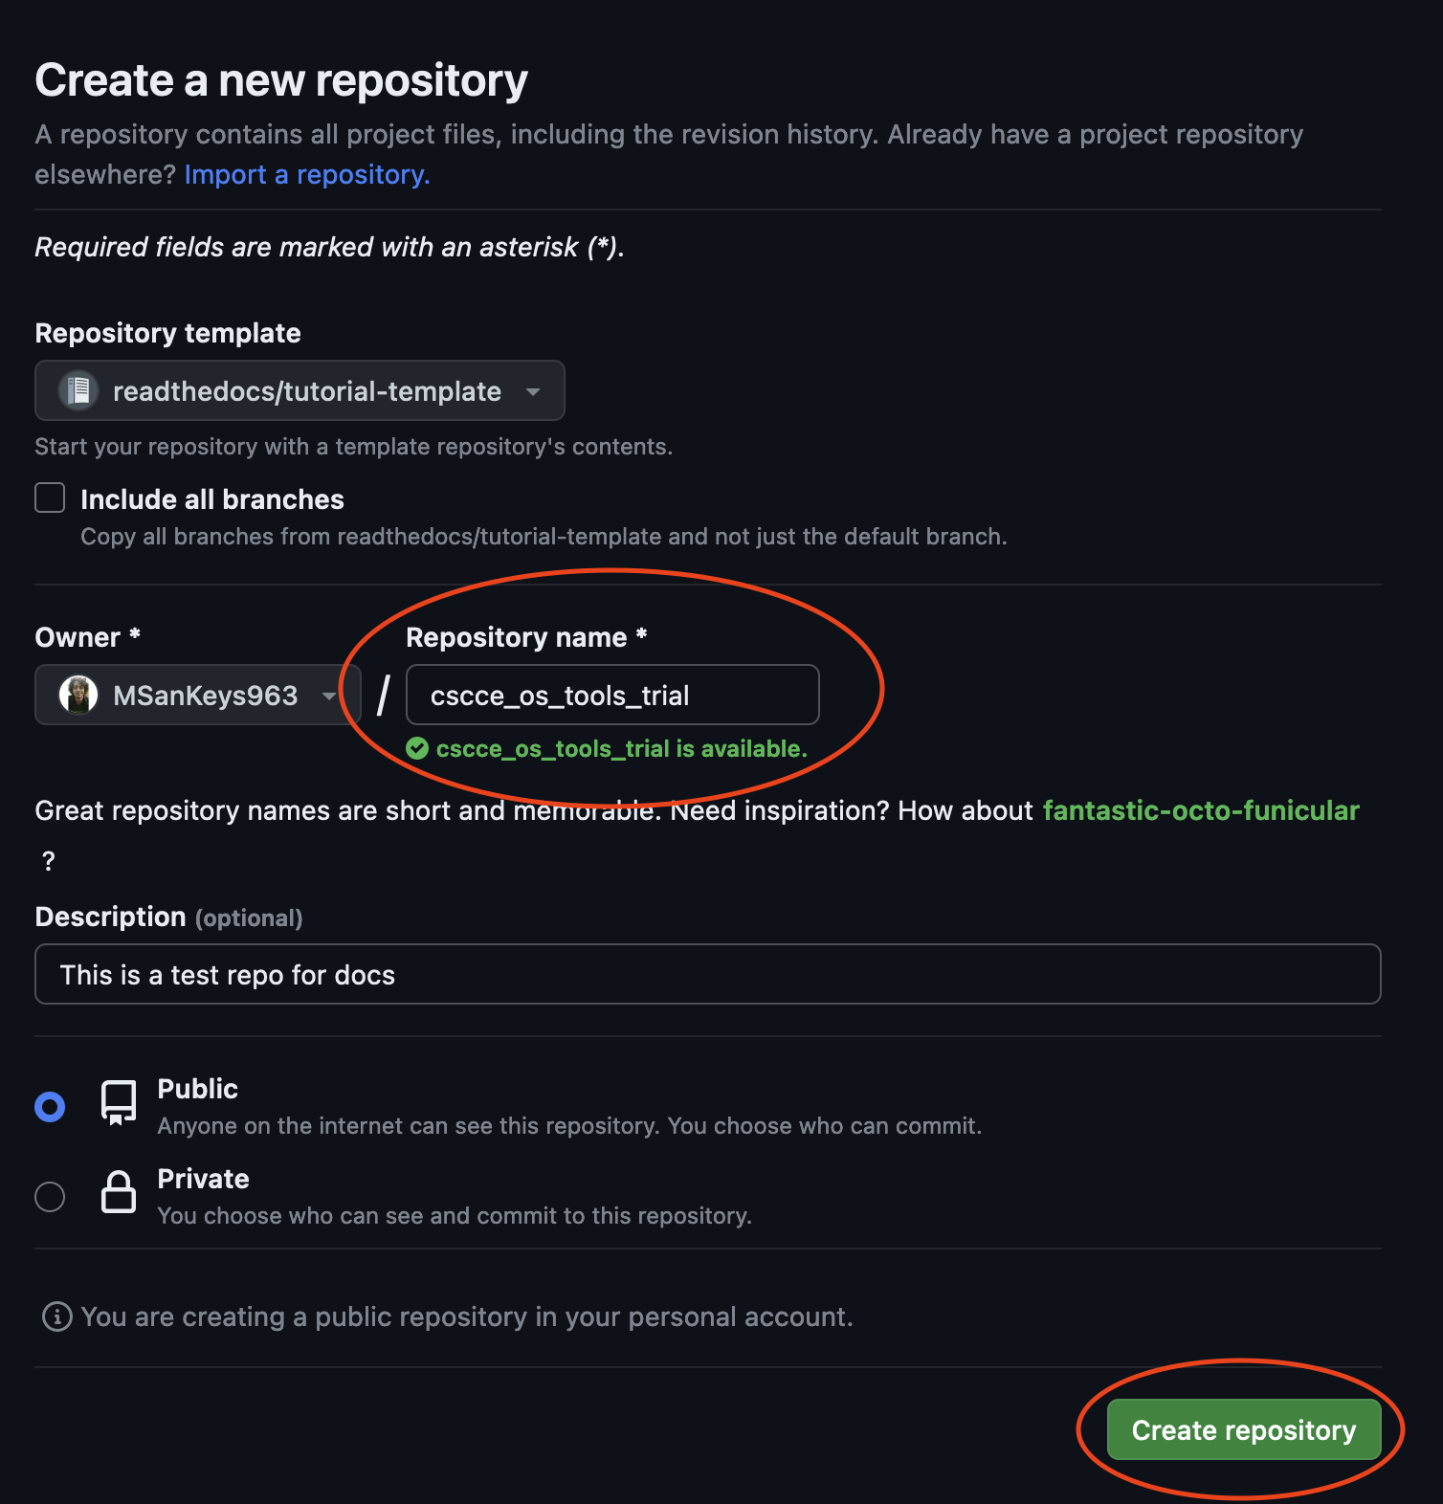

Slide 9

Sign up
Using GitHub account
https://readthedocs.org/accounts/signup/

Slide 10
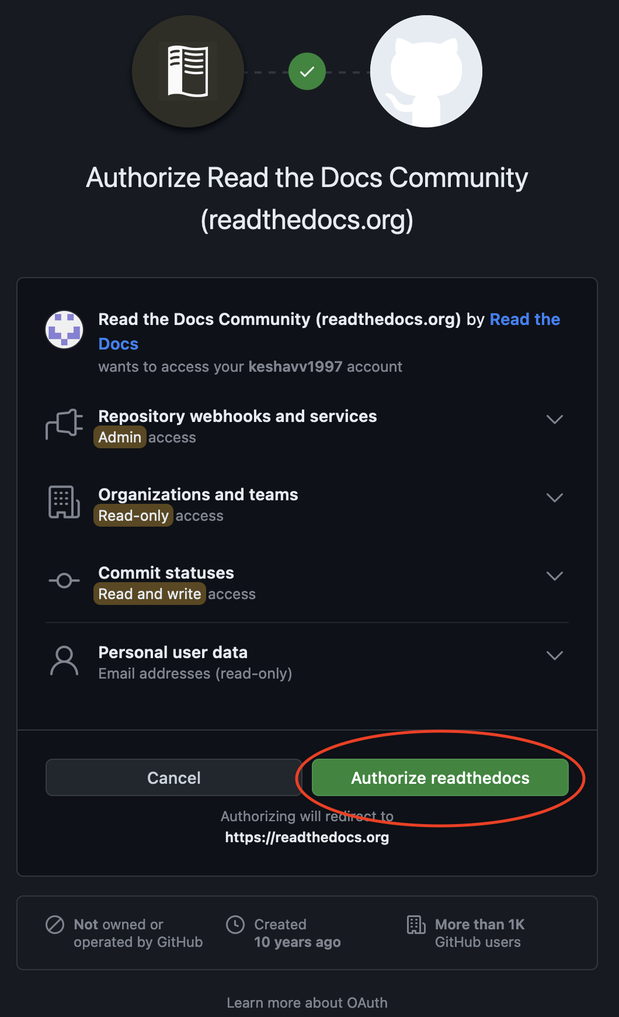

Slide 11
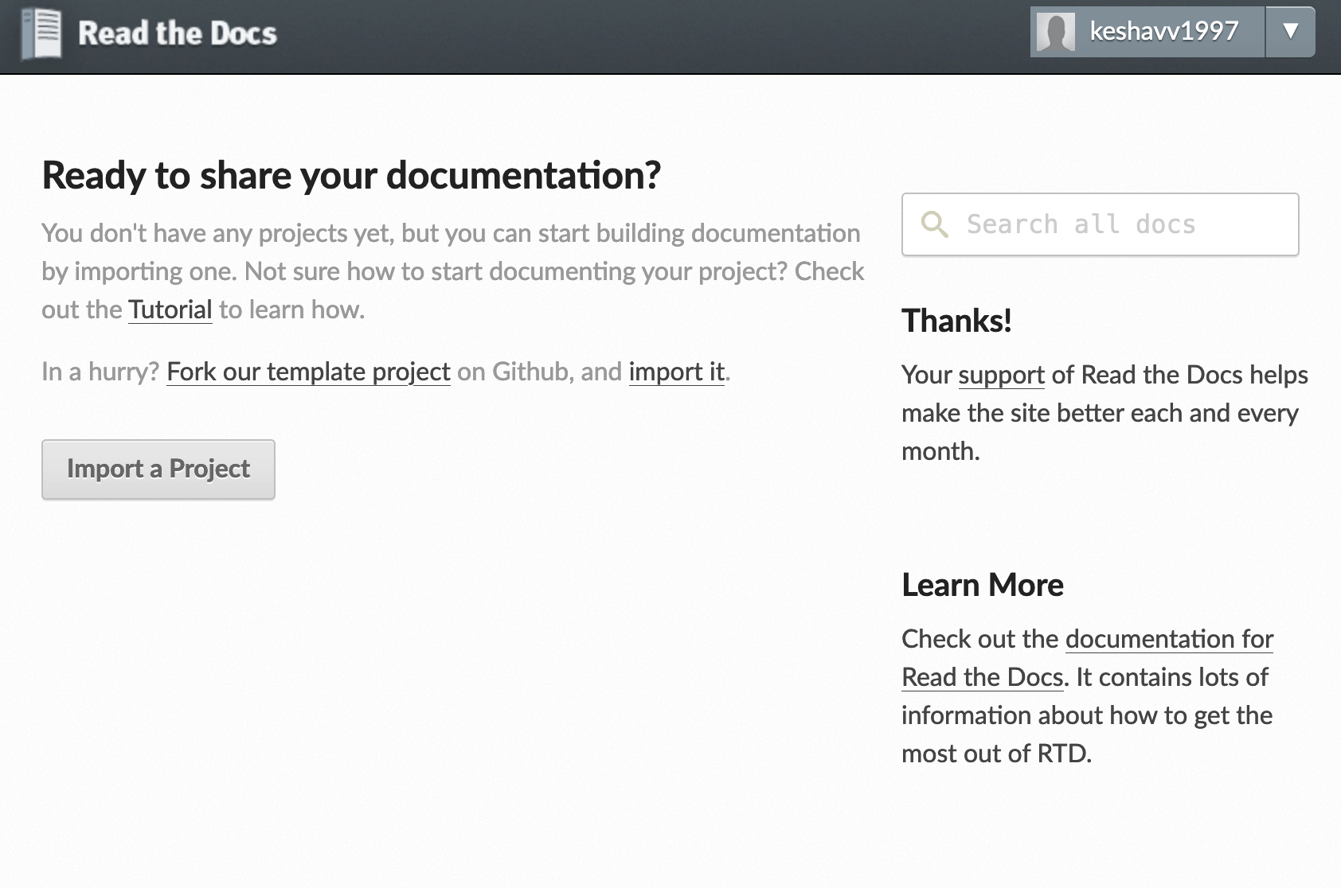
ReadtheDocs Dashboard

Slide 12


Slide 13
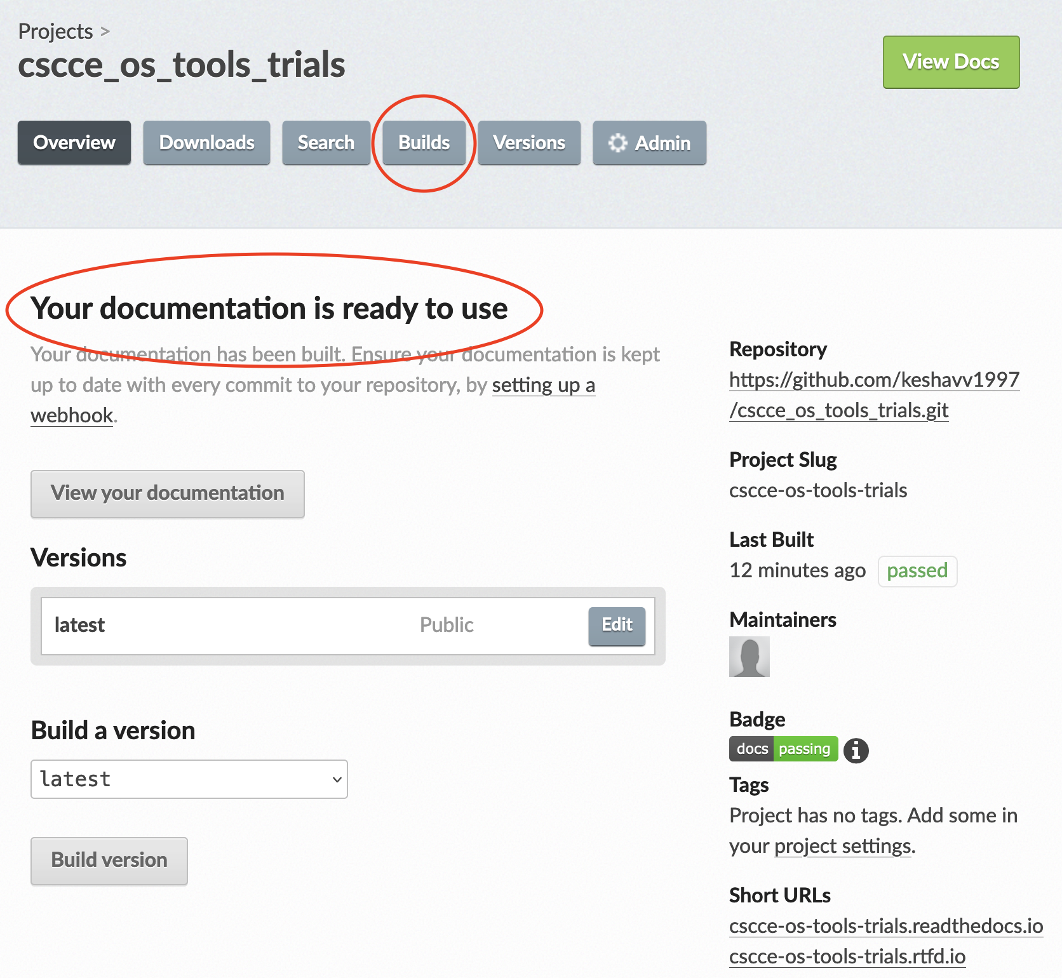

Slide 14
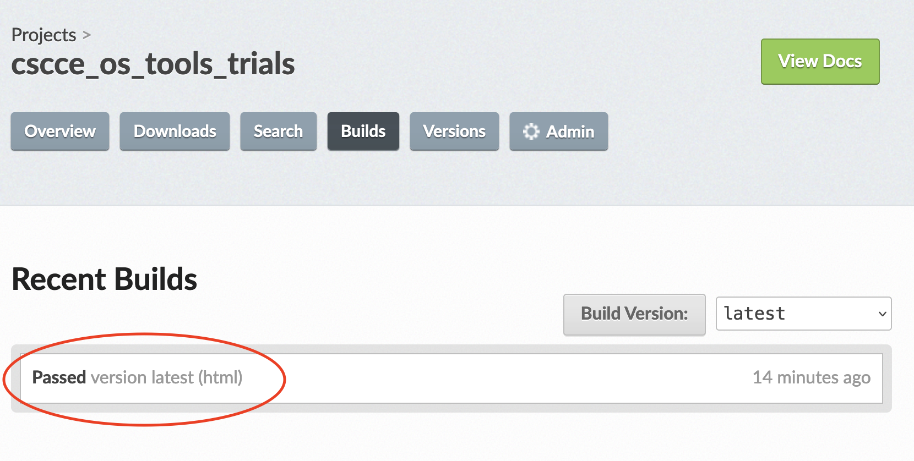

Slide 15
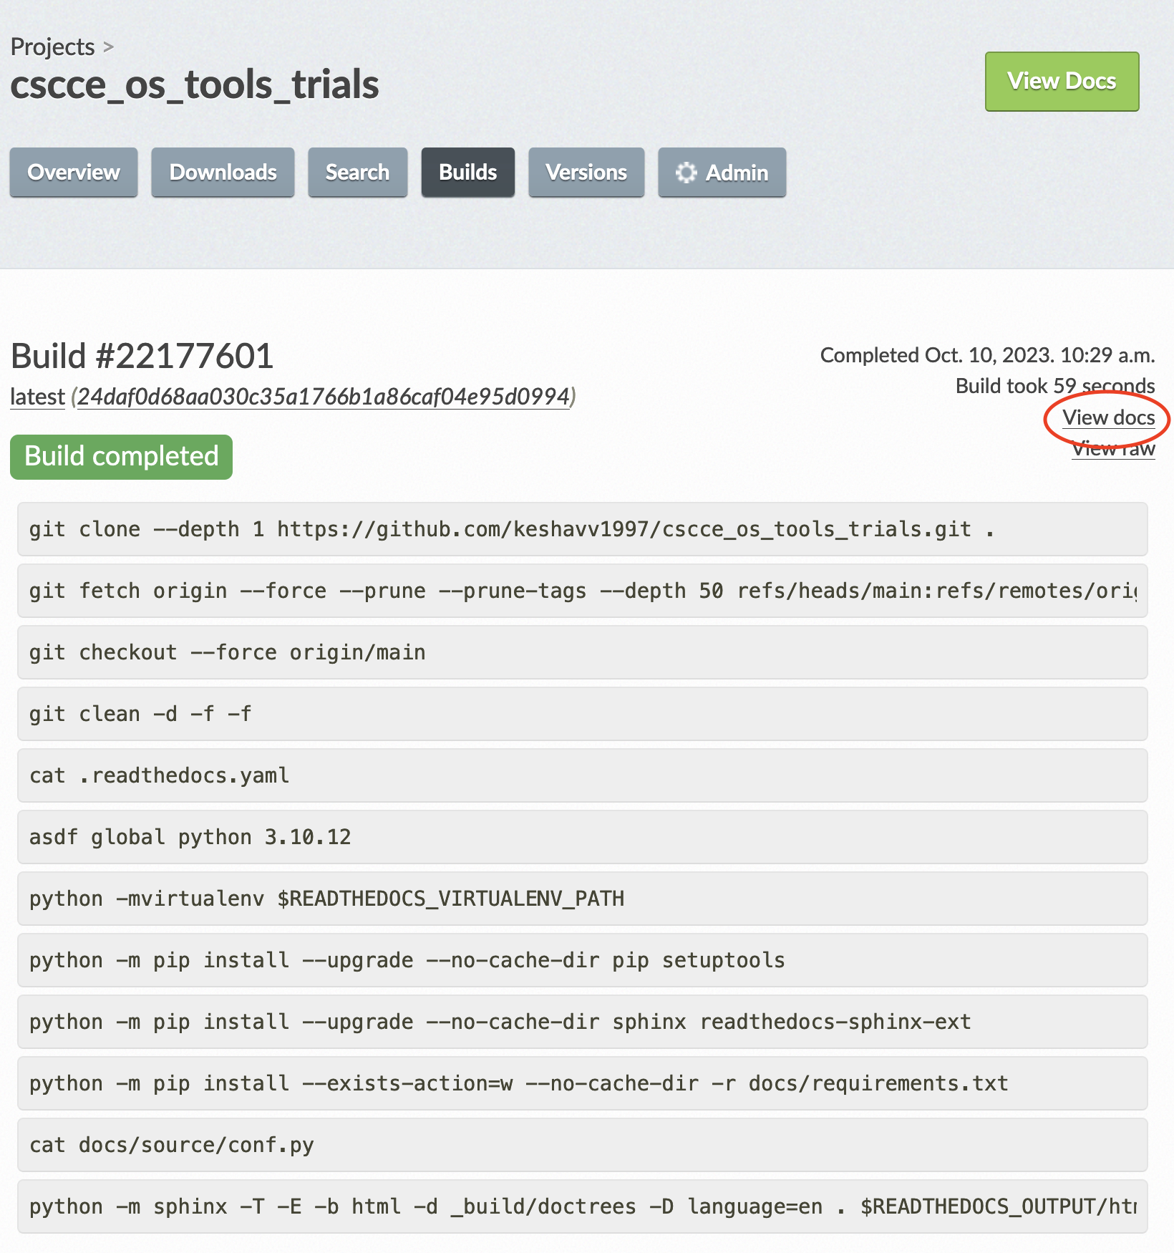

Slide 16

Check the docs
https://cscce-os-tools-trials.readthedocs.io/en/latest/

Slide 17
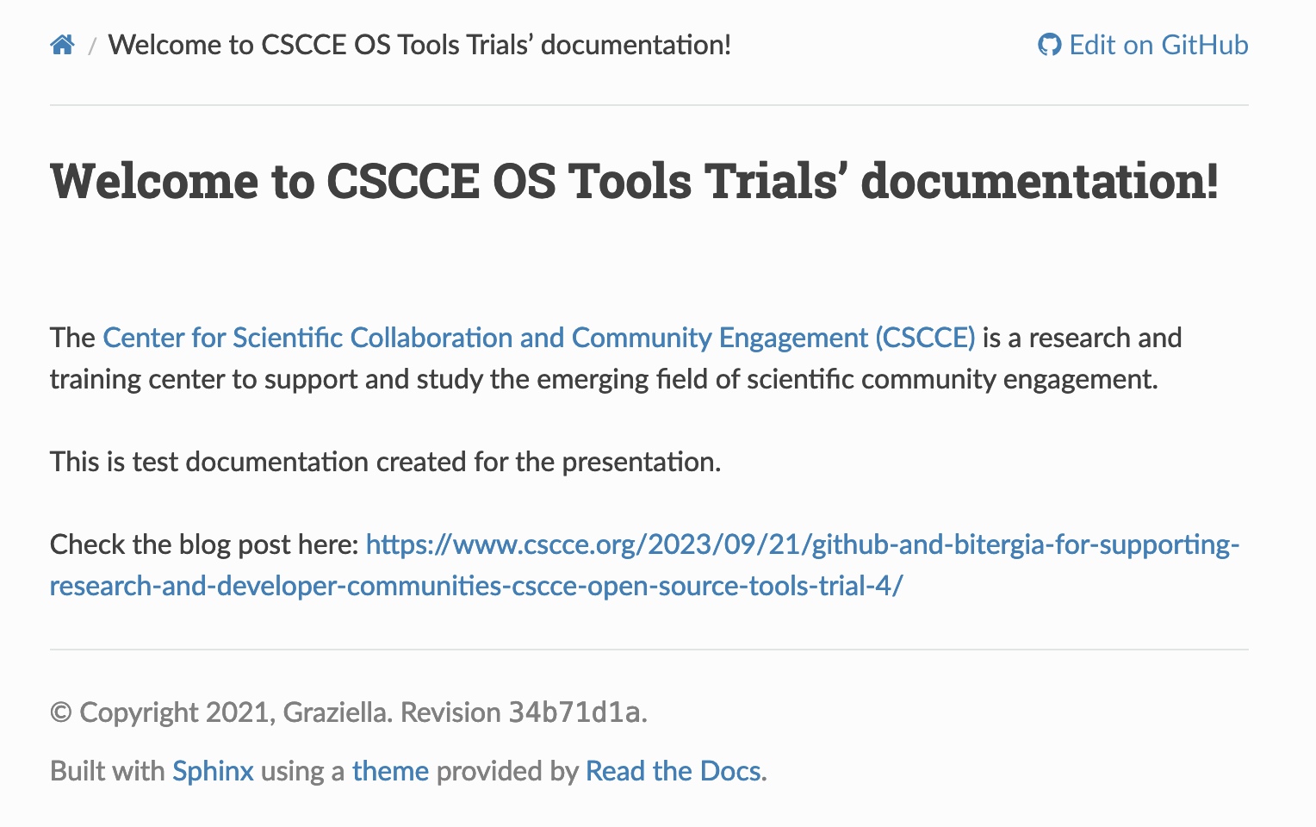

Slide 18
Zarr Community

Slide 19


Slide 20
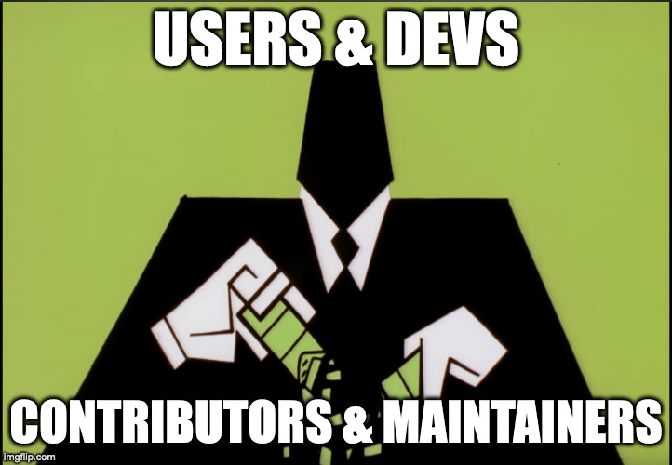

Slide 21


Slide 22


Slide 23


Slide 24


Slide 25


Slide 26


Slide 27


Slide 28
How we’re using Git & GitHub?

Slide 29
GitHub offers a range of features!
~ Issues to raise a concern/feature/discuss/track progress
~ Pull Requests (PR) to submit changes to code/documentation
~ Project boards to organise workflow, create roadmaps etc.
~ GH Discussions for polls, QnA, general discussions in threaded style

Slide 30
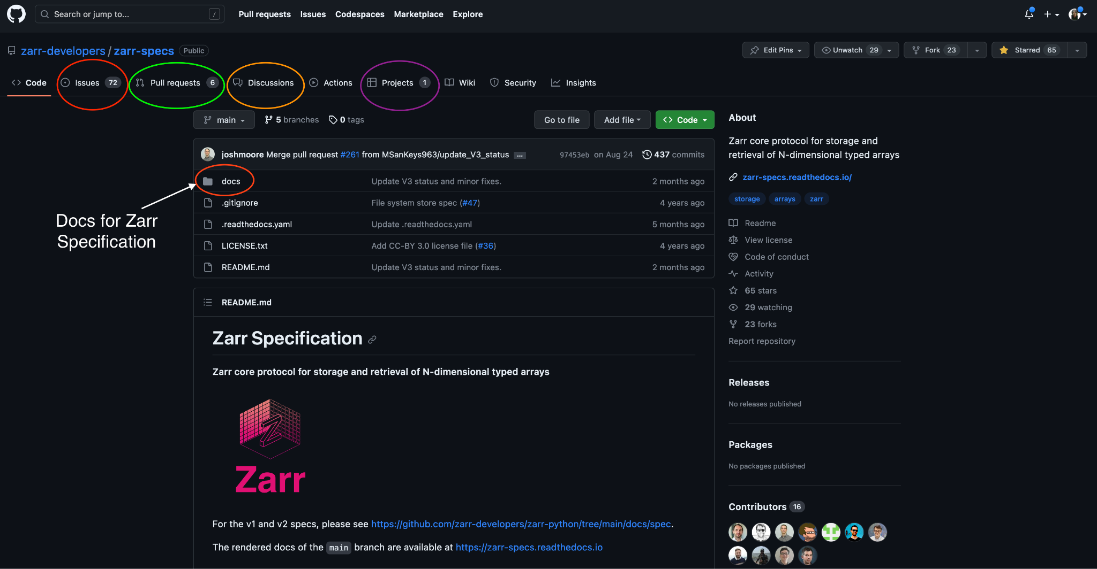

Slide 31
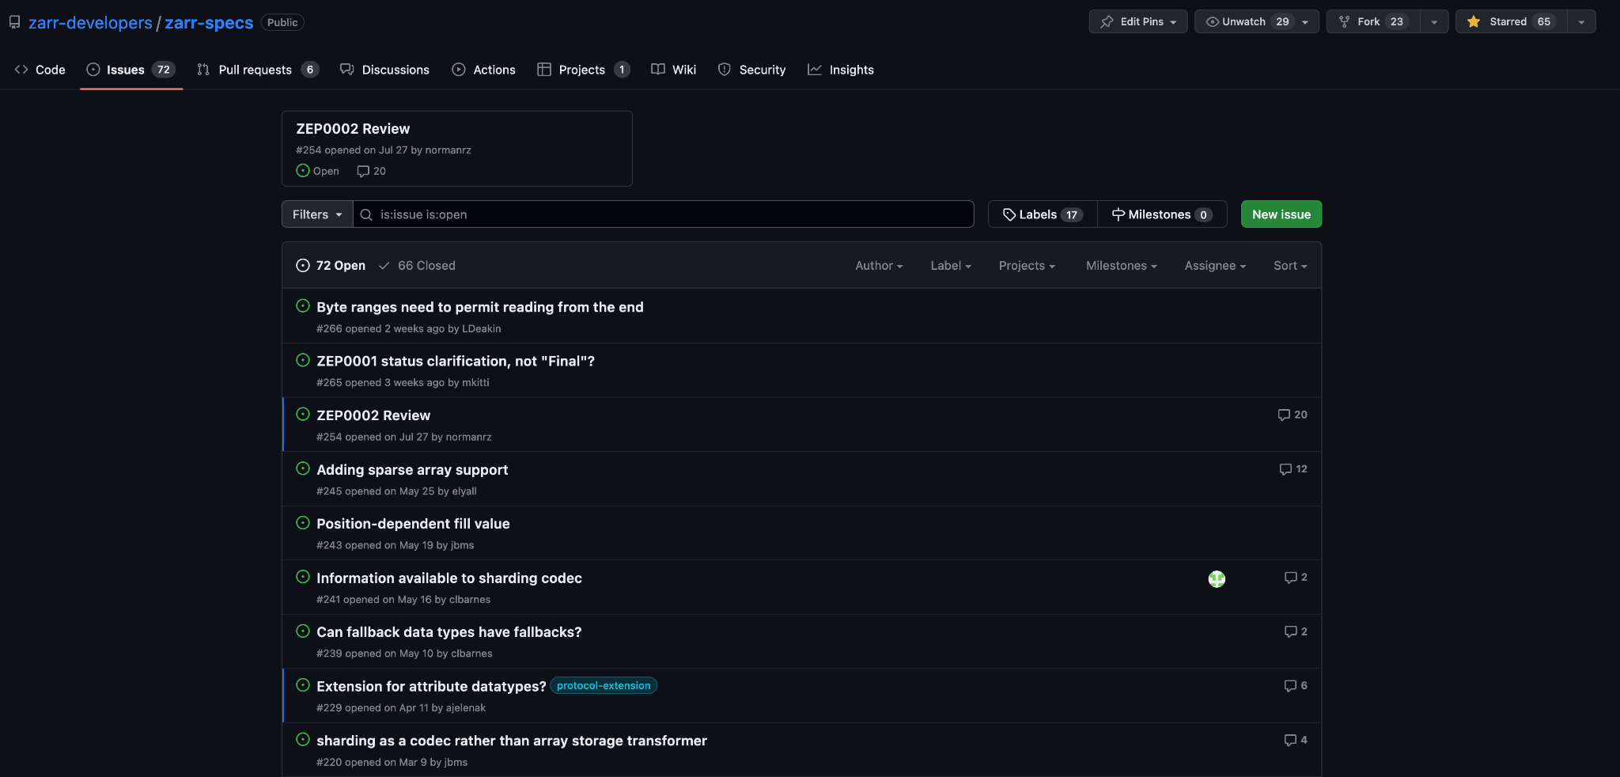
Issue Tracker 👣

Slide 32
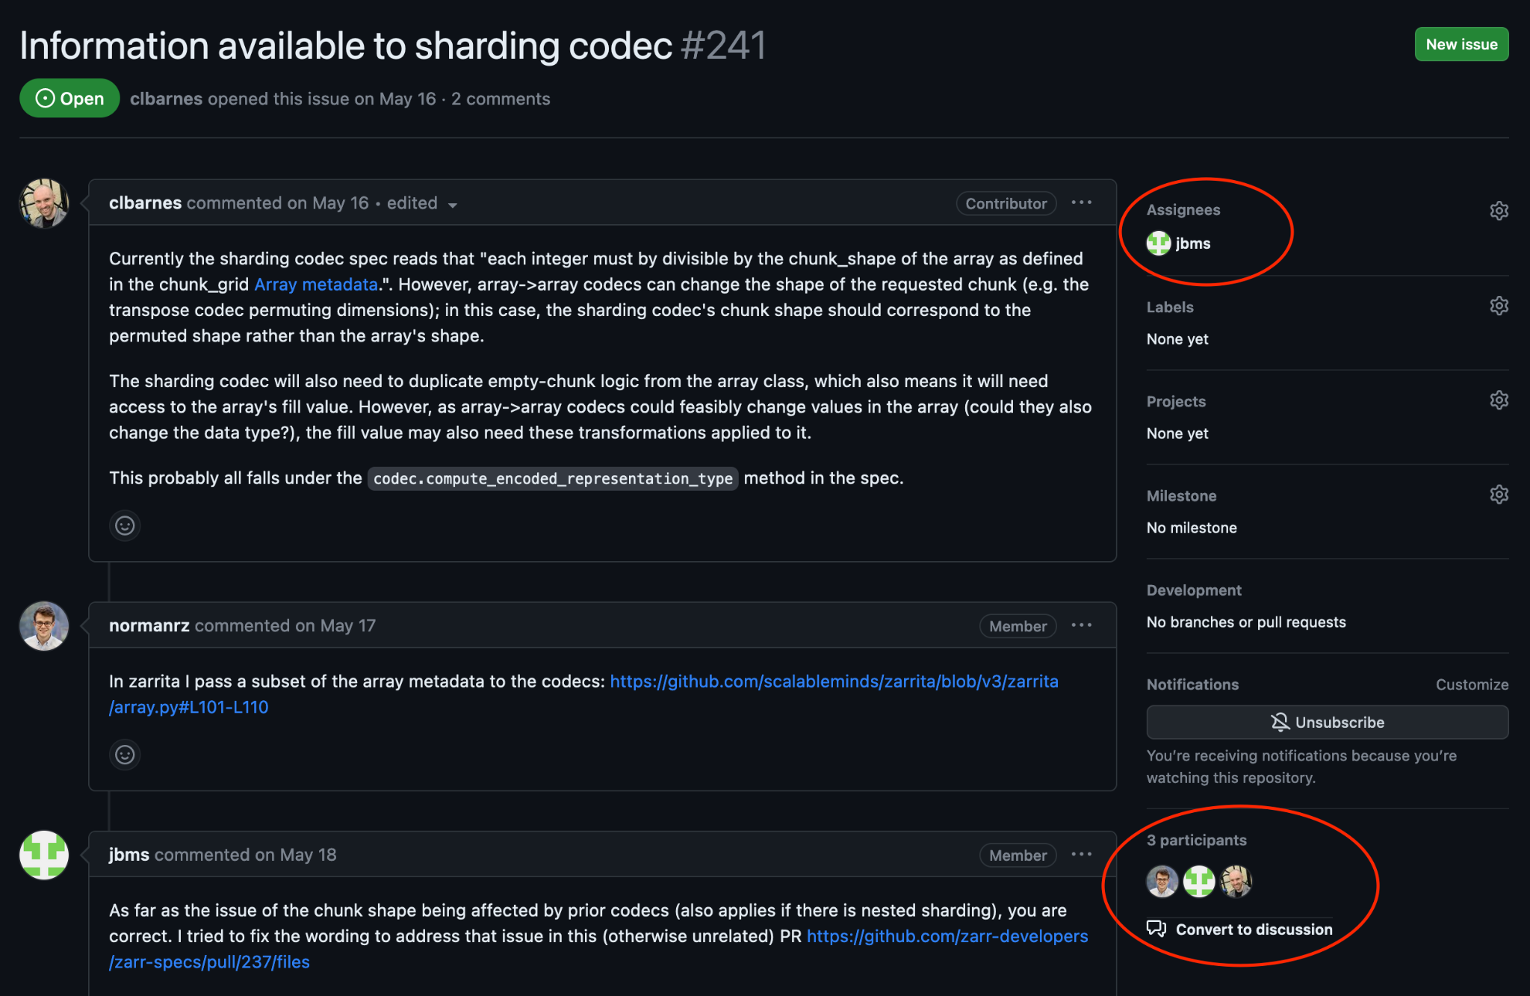

Slide 33
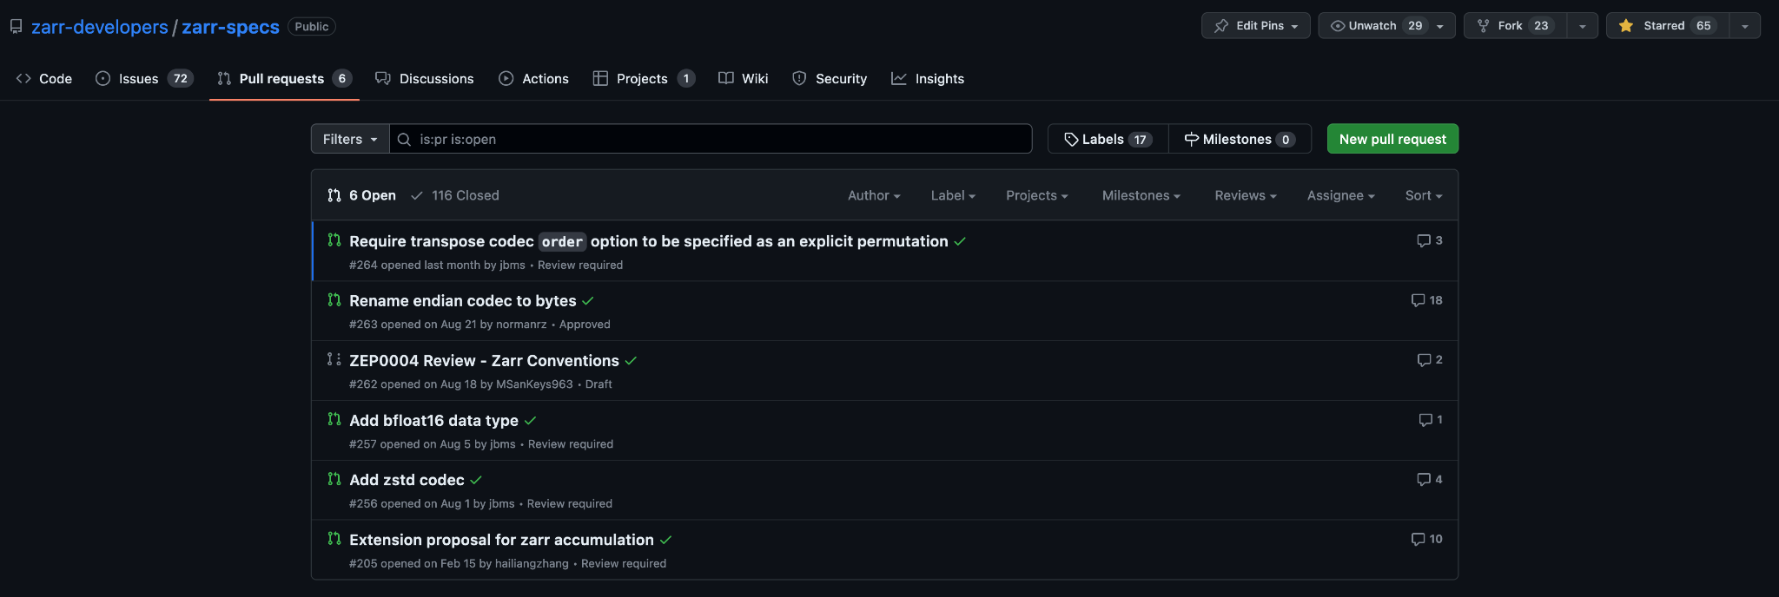
Pull Requests 🙏🏻

Slide 34
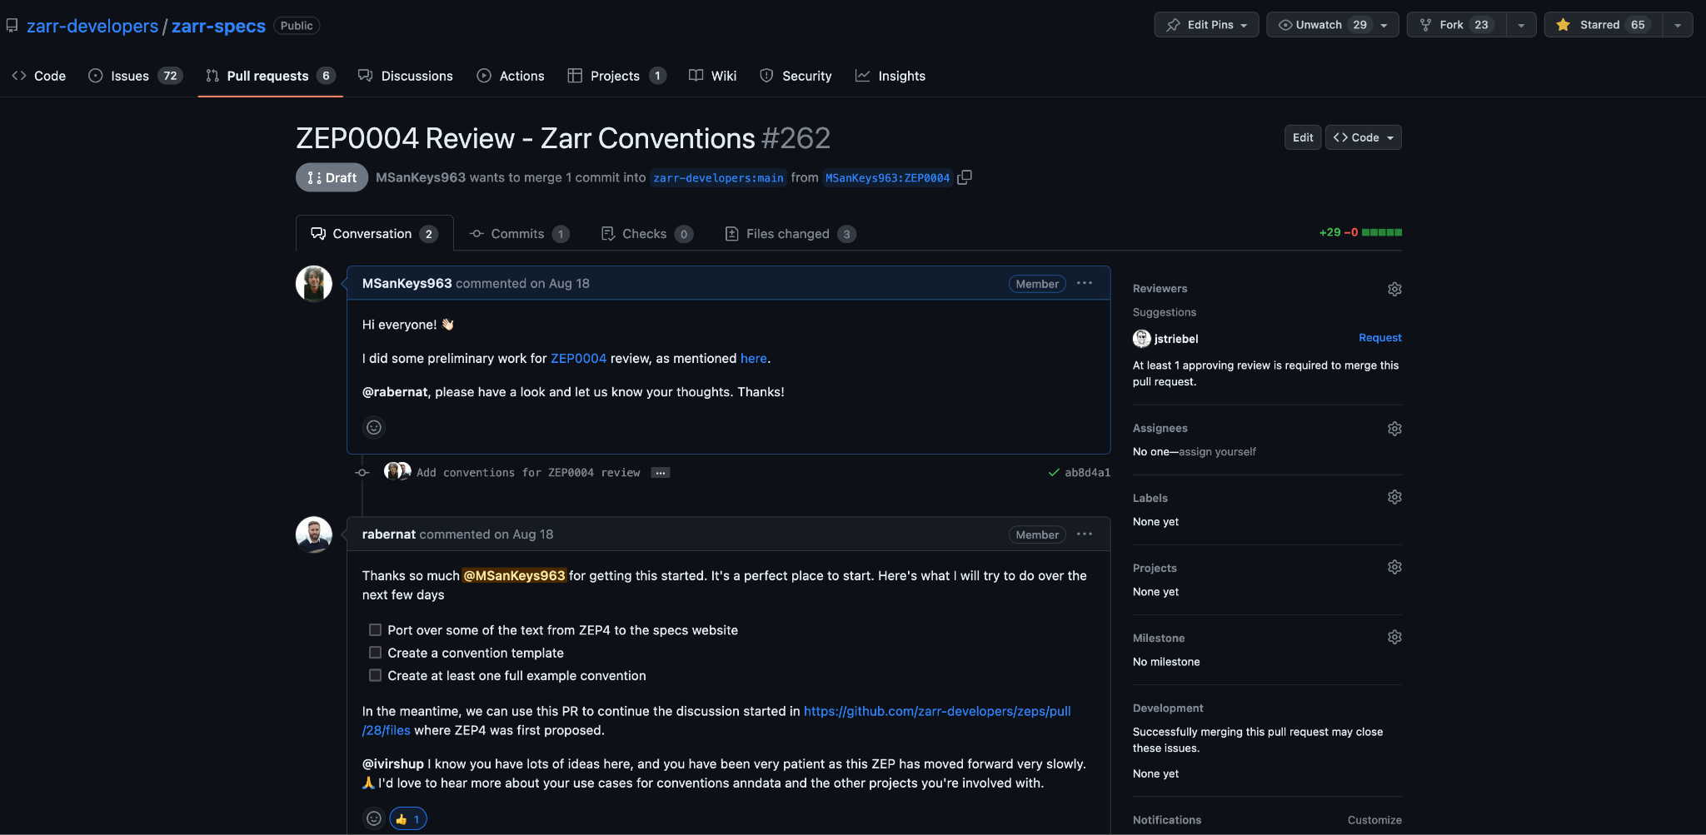

Slide 35
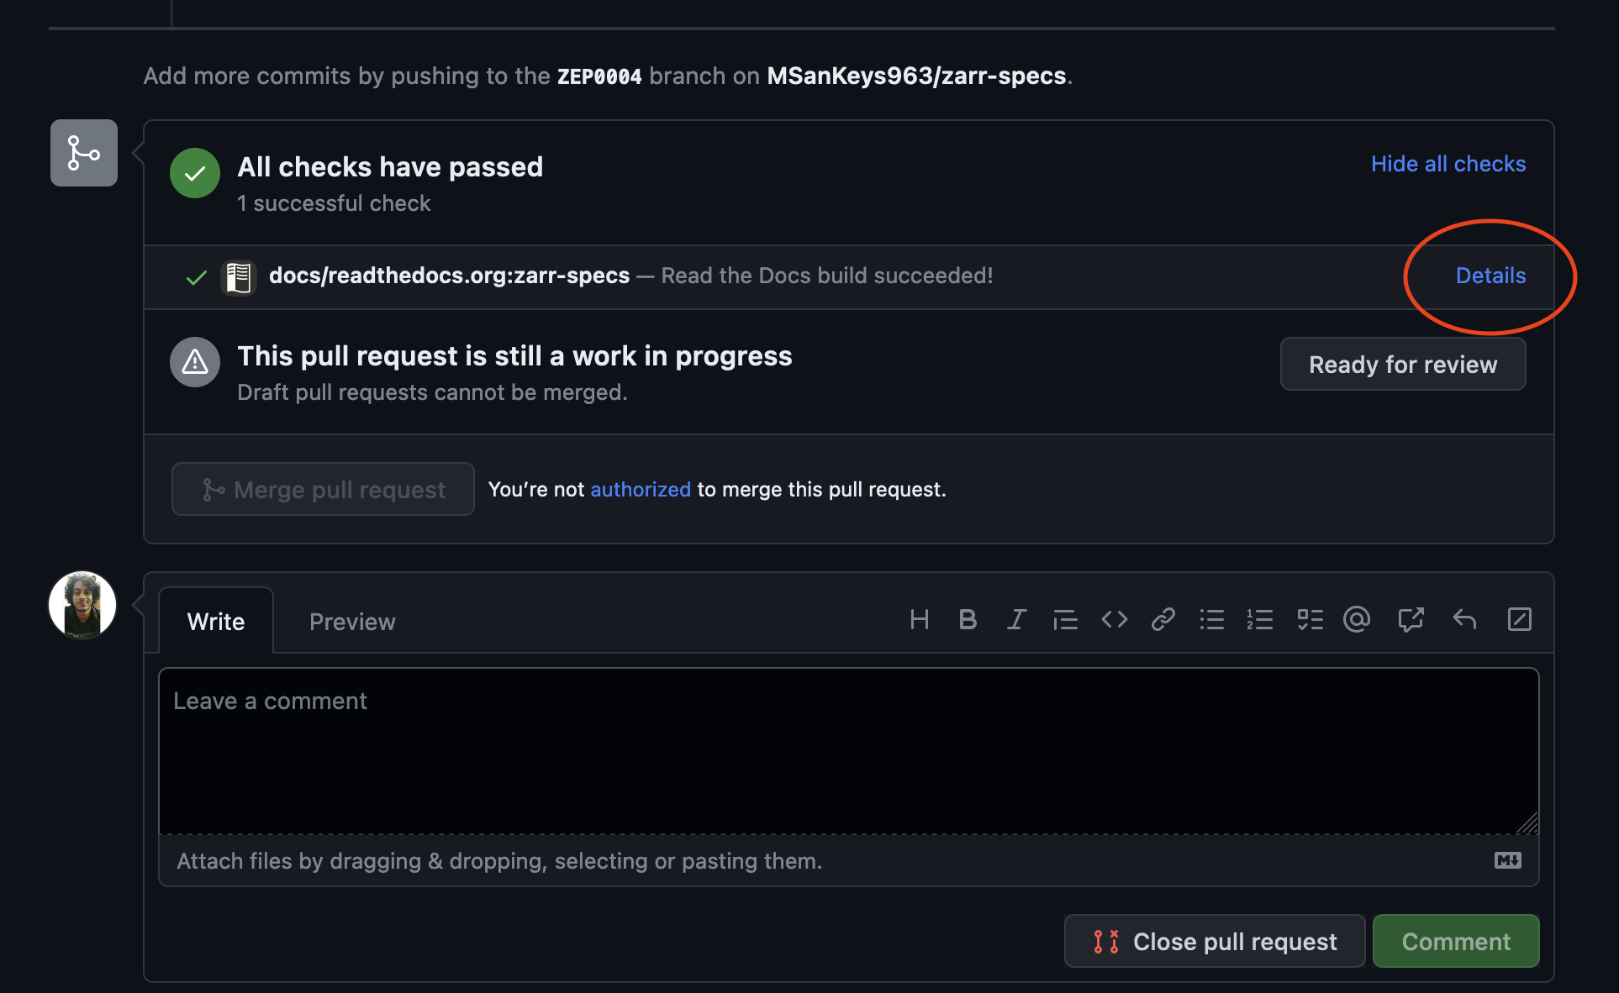

Slide 36
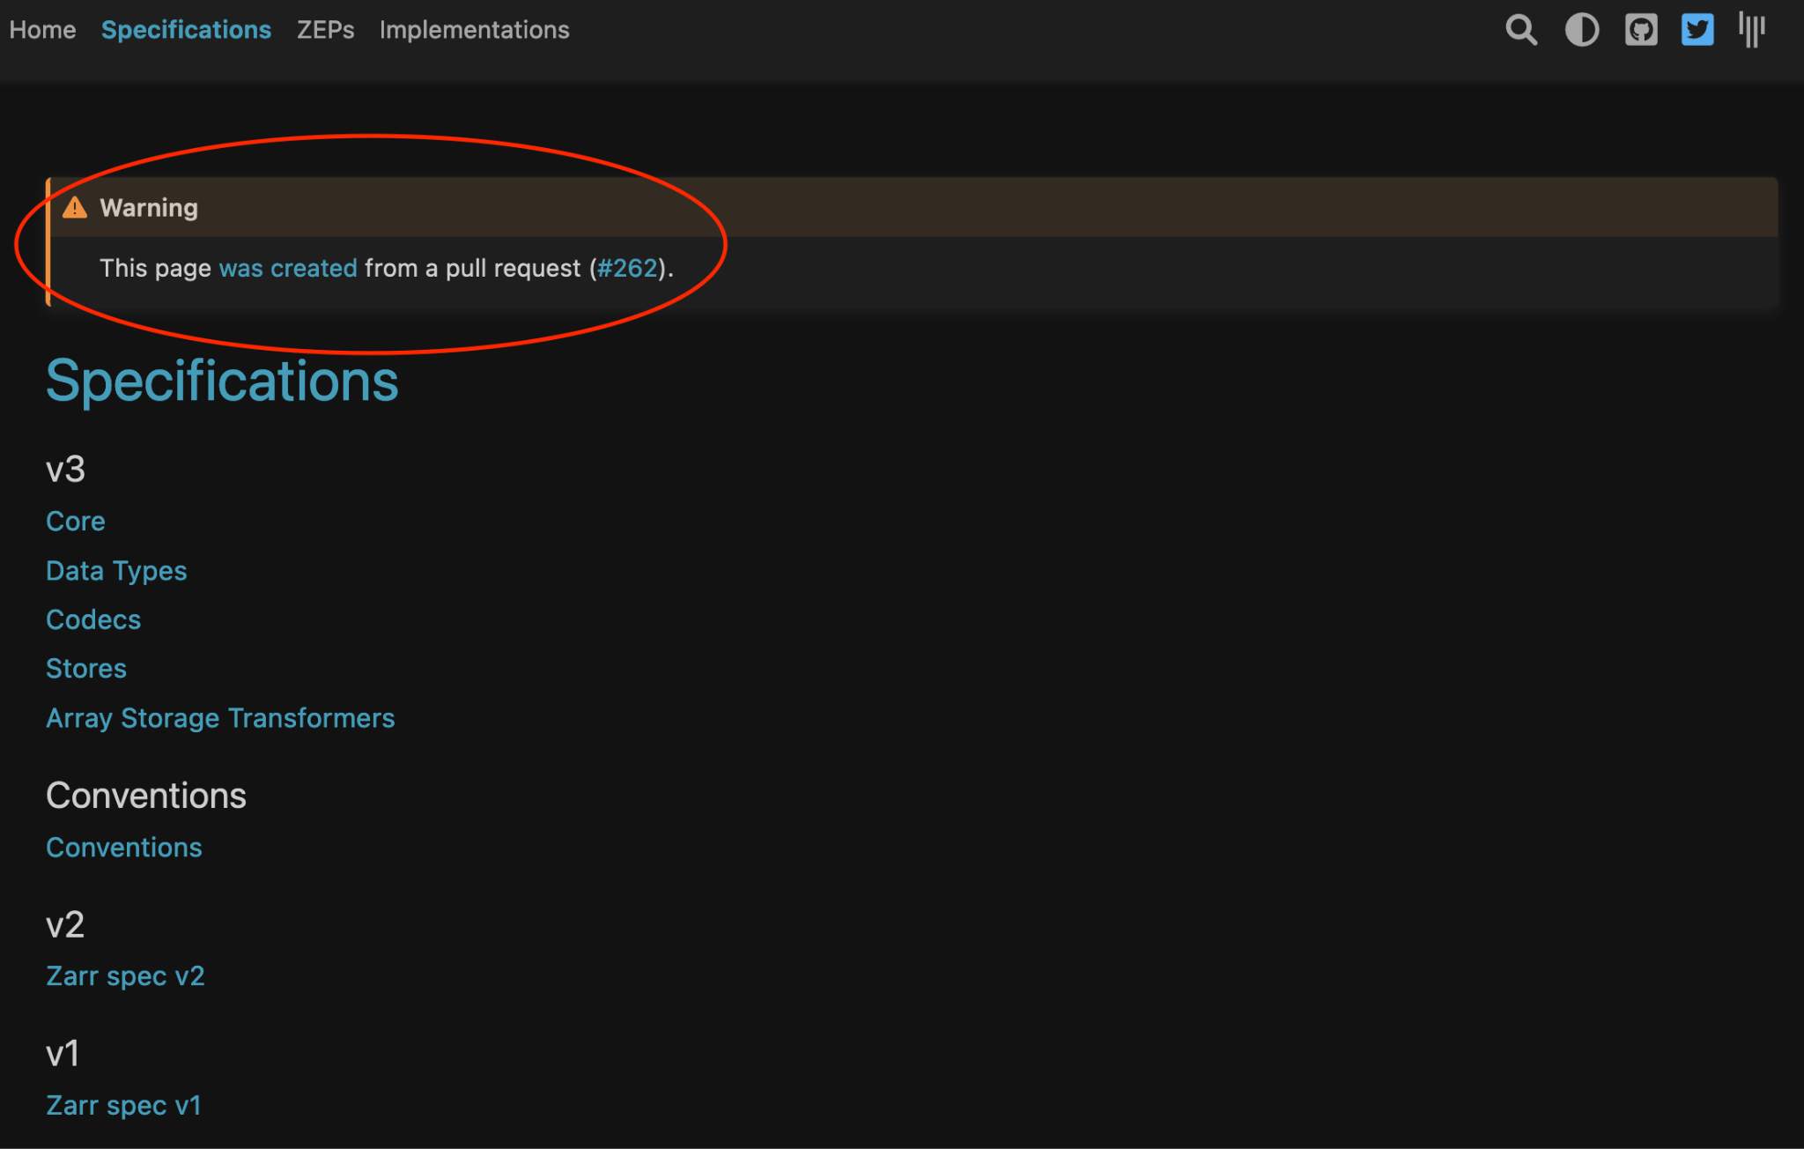

Slide 37
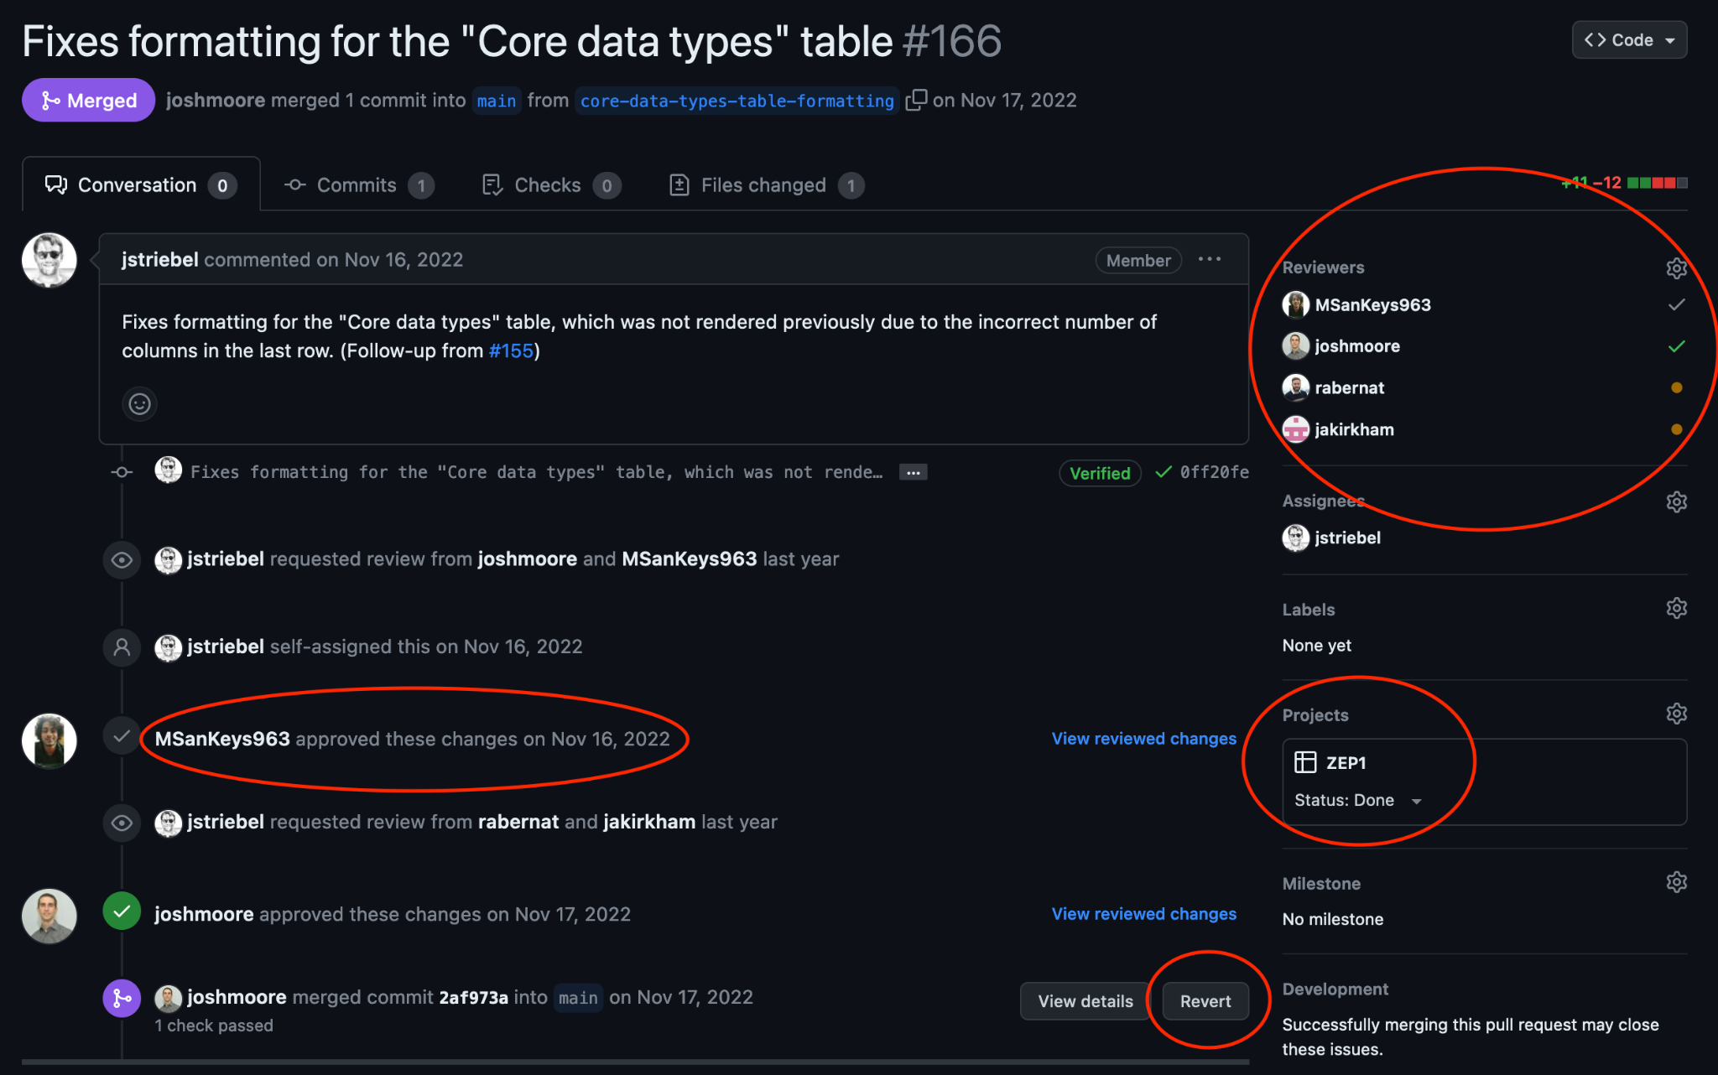

Slide 38
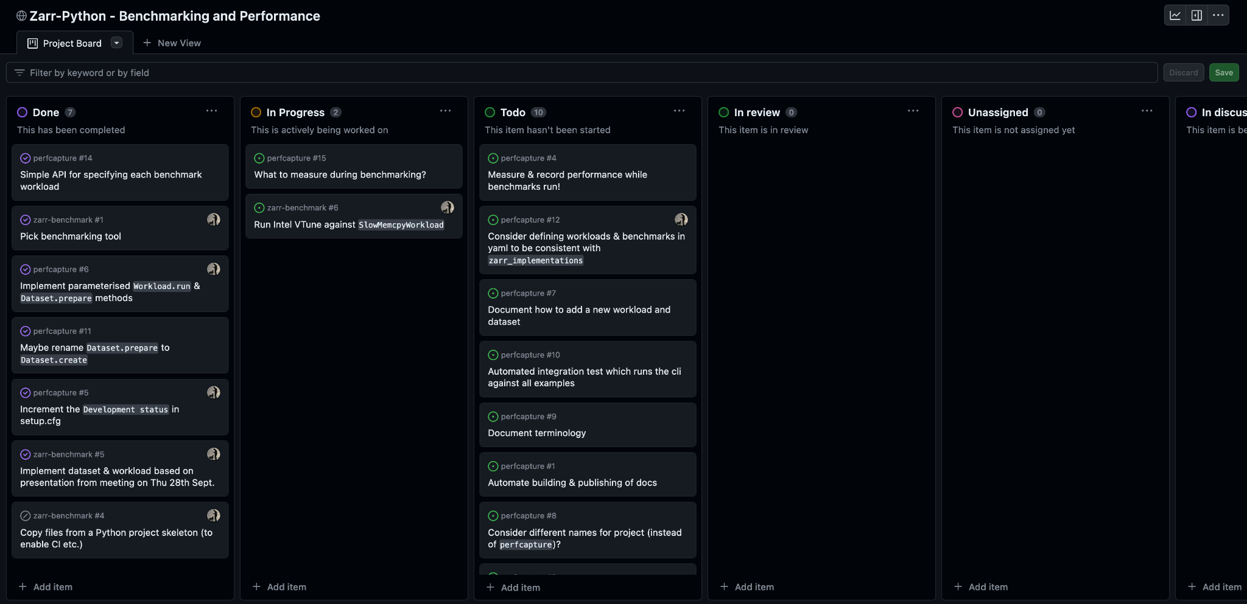
Project Board 📝

Slide 39
Git lets you keep track of versioning and changes via commits 🤝🏻

Slide 40
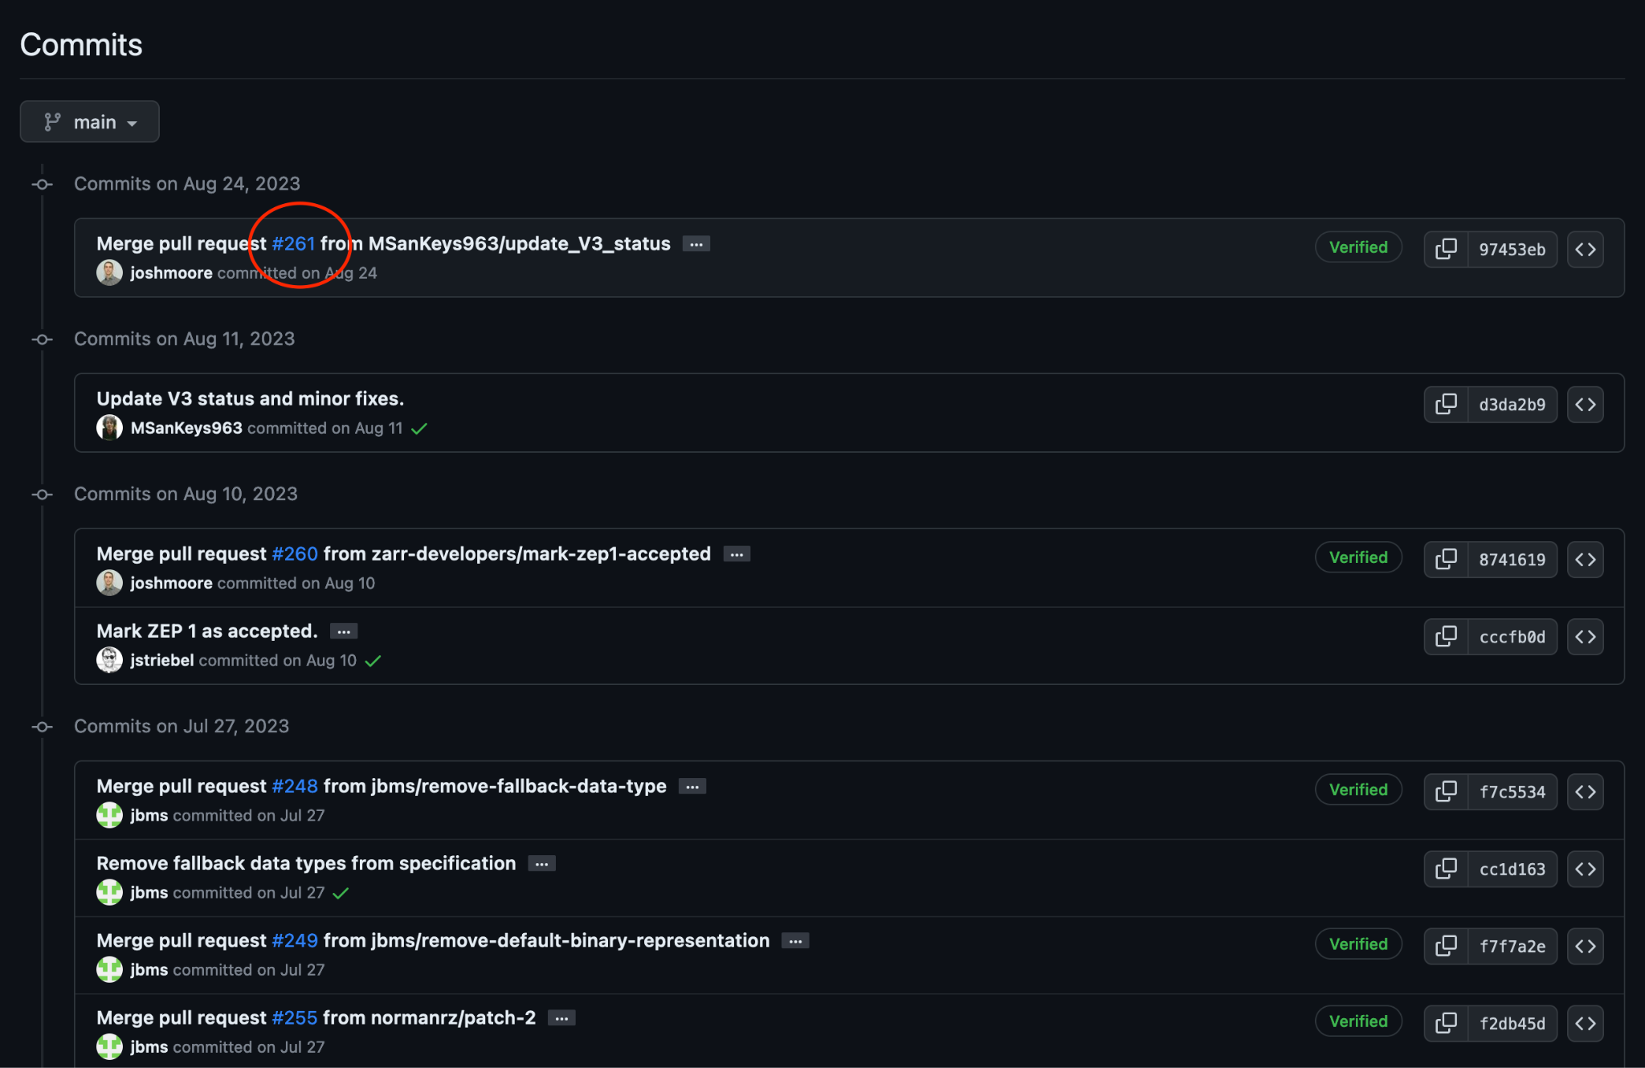

Slide 41
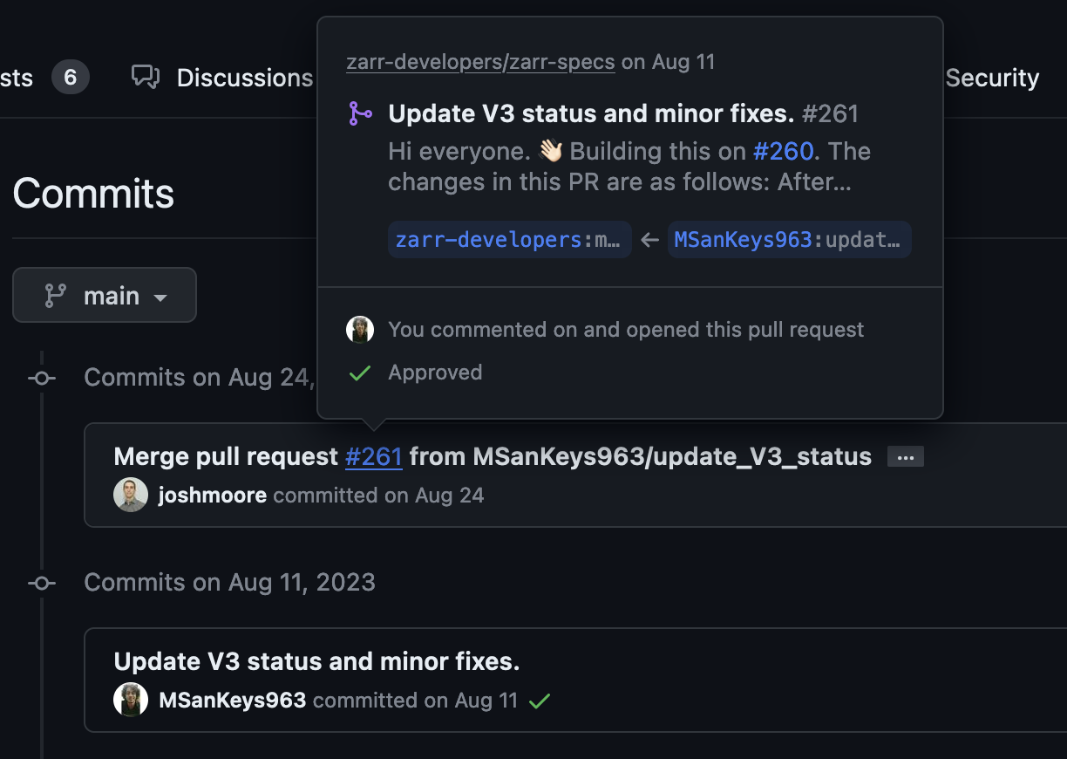

Slide 42
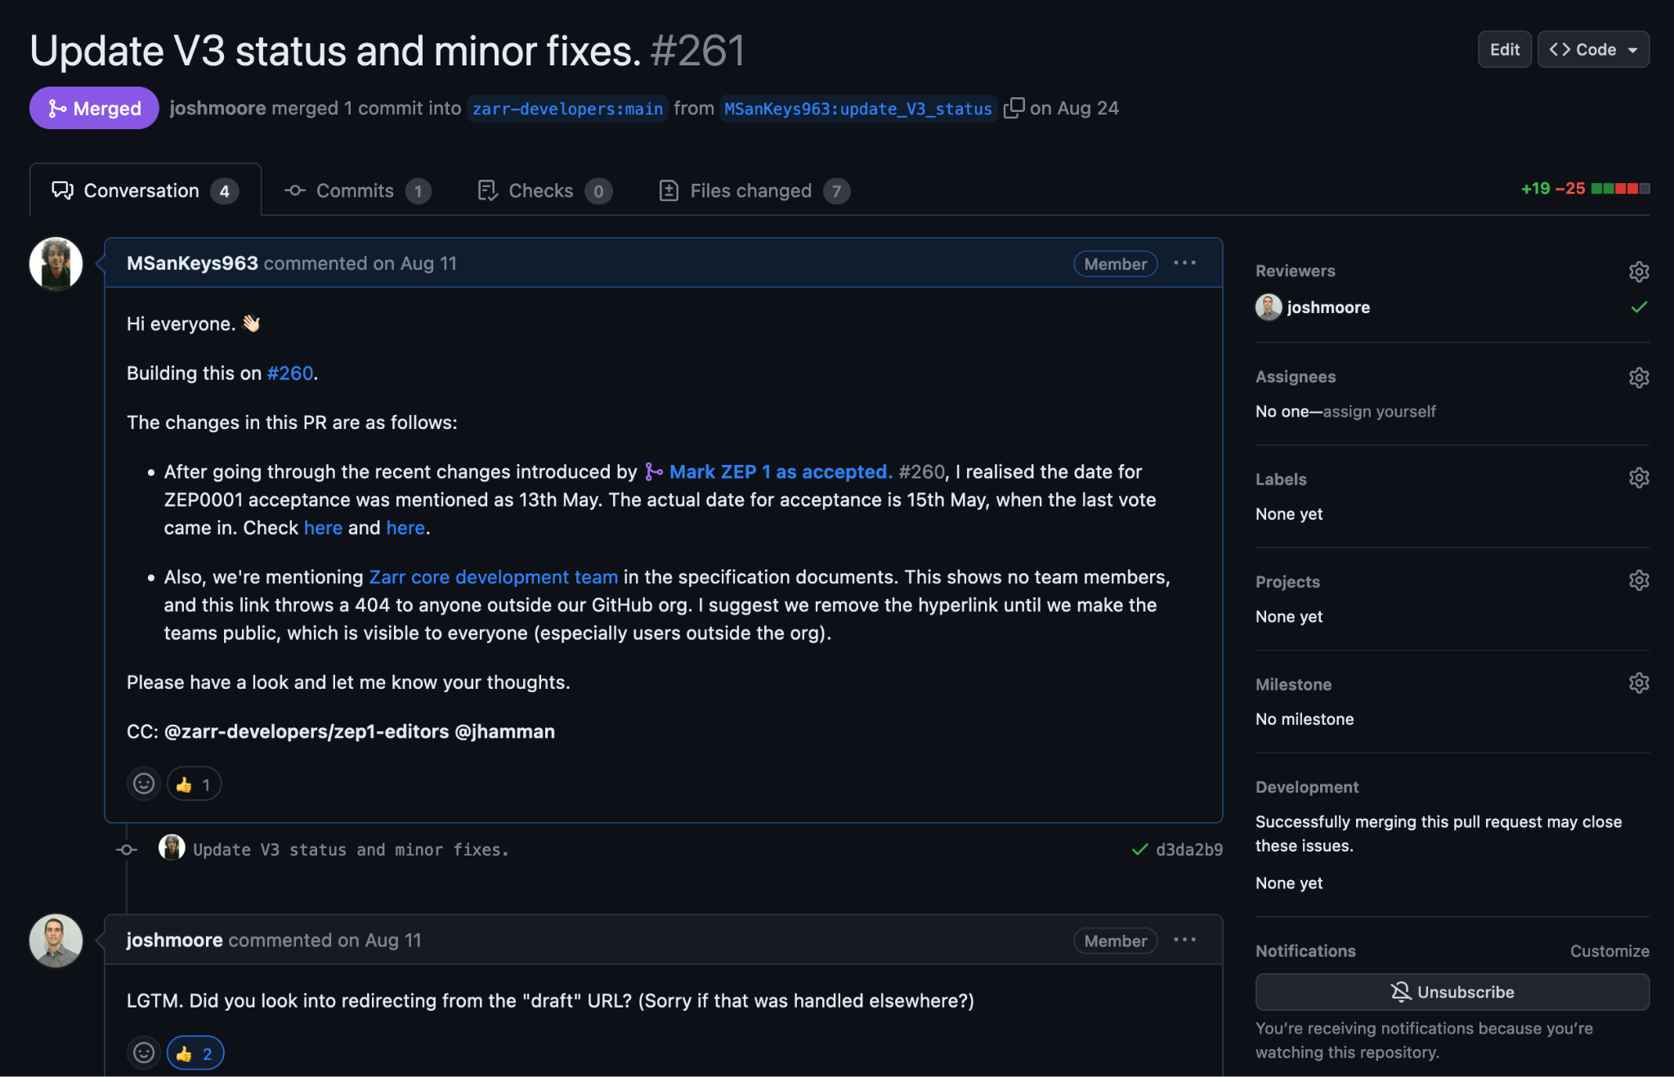

Slide 43
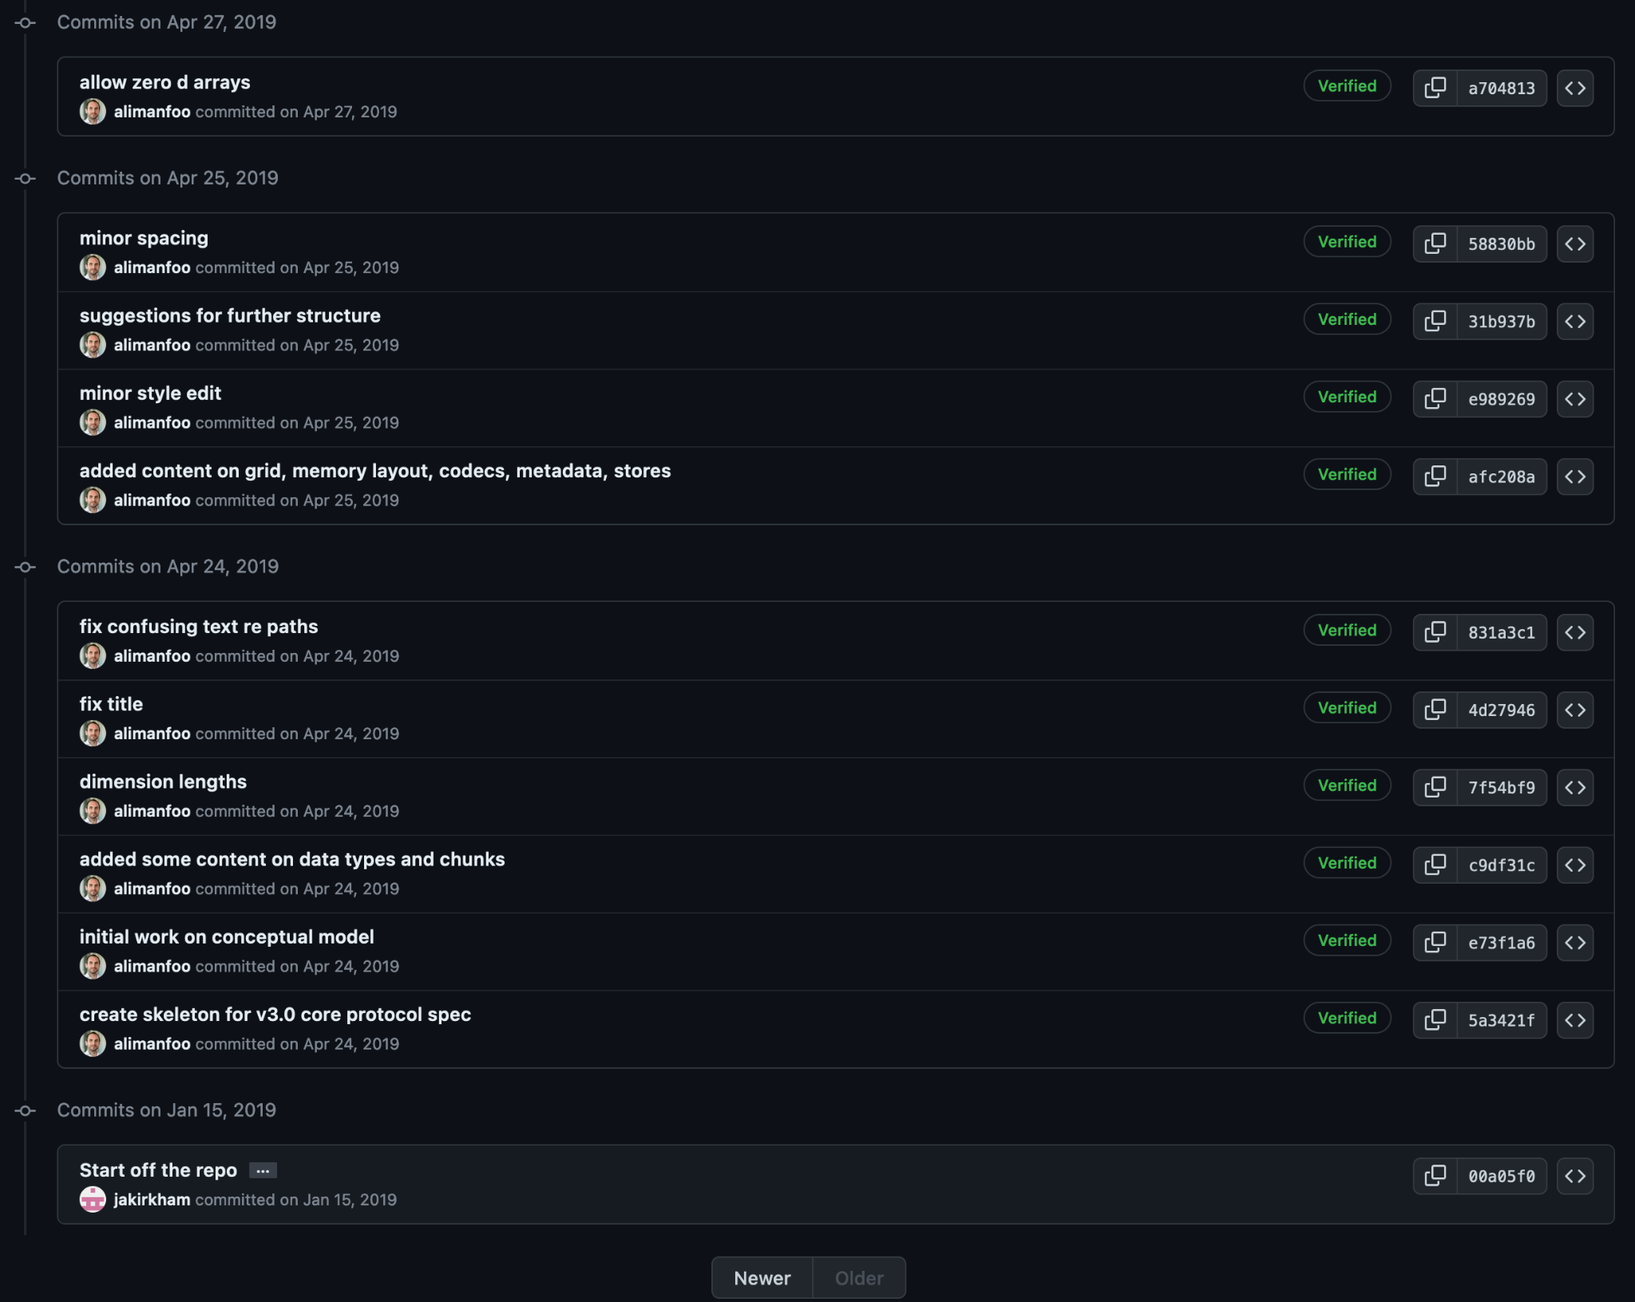

Slide 44

Zarr Specification
V1 → V2 → V3
https://zarr-specs.readthedocs.io/

Slide 45
Peak into the ZEP Process 👀

Slide 46
Dialing back to…

Slide 47
We have a large and diverse active community!
But…👀

Slide 48
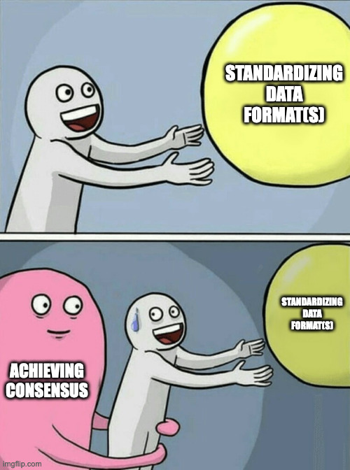


Slide 49
We needed a structured way to solicit and *process* the feedback!

Slide 50
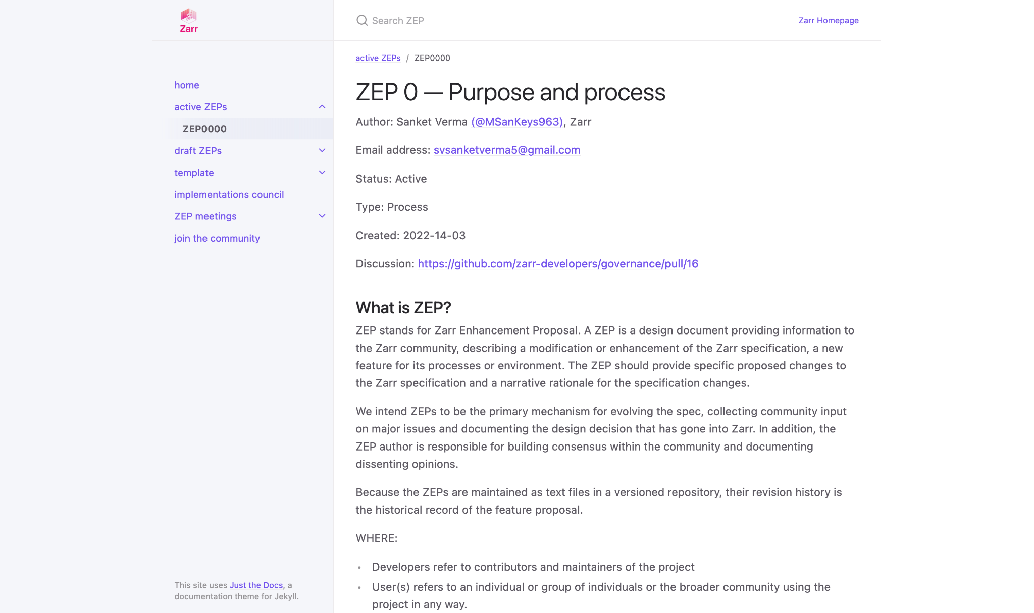
zarr.dev/zeps

Slide 51
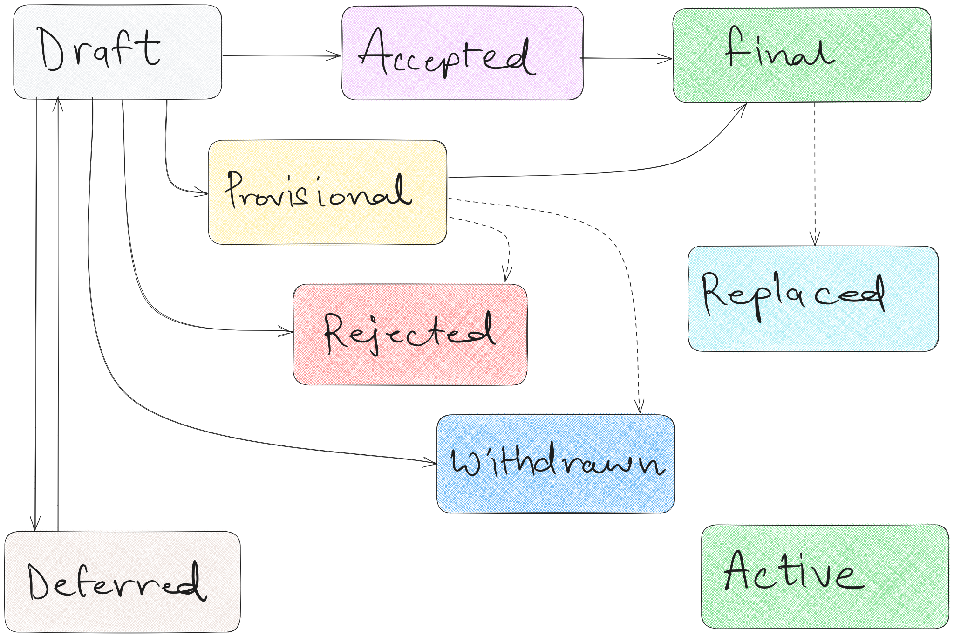
ZEP Flowchart ⤴↖↔

Slide 52

Braindump 🧠
ZEP Inception Blog post

Slide 53

Thank you! 🙏🏻
@zarr_dev

